Slide 1
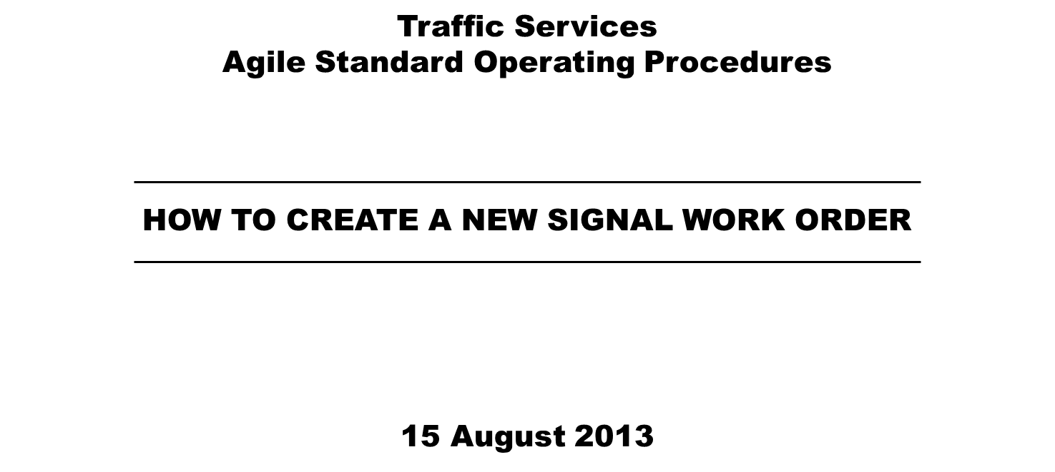

Slide 2
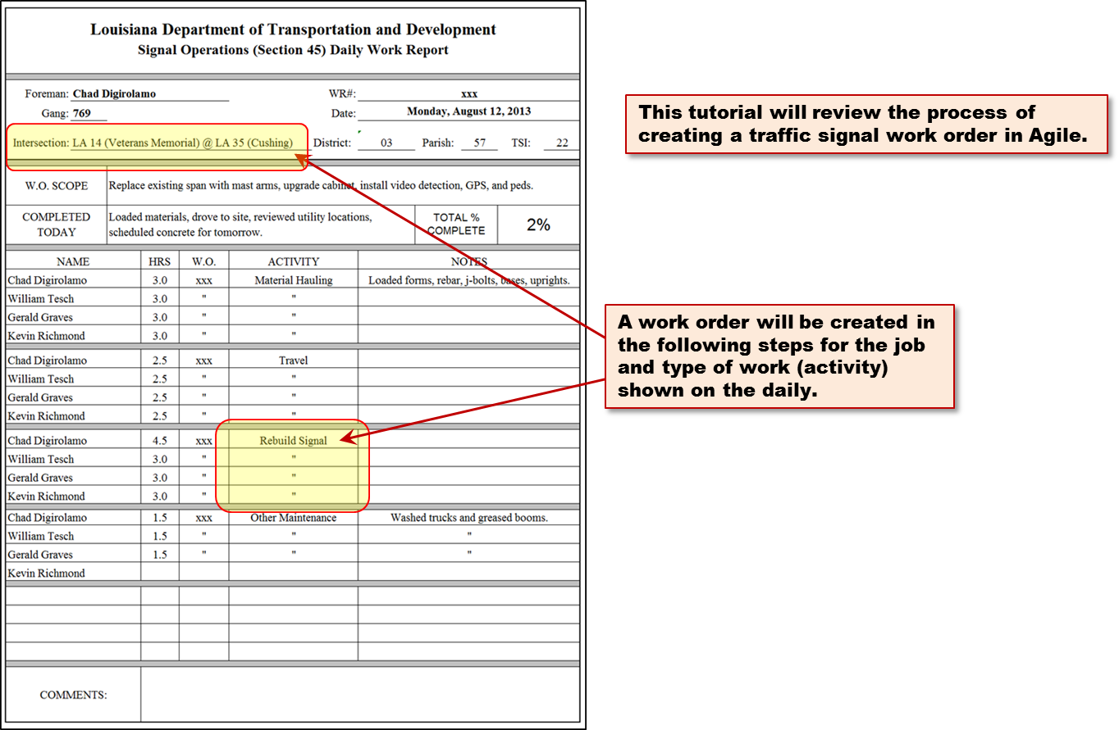
HOW TO CREATE A NEW SIGNAL WORK ORDER

Slide 3
HOW TO CREATE A NEW SIGNAL WORK ORDER

Slide 4
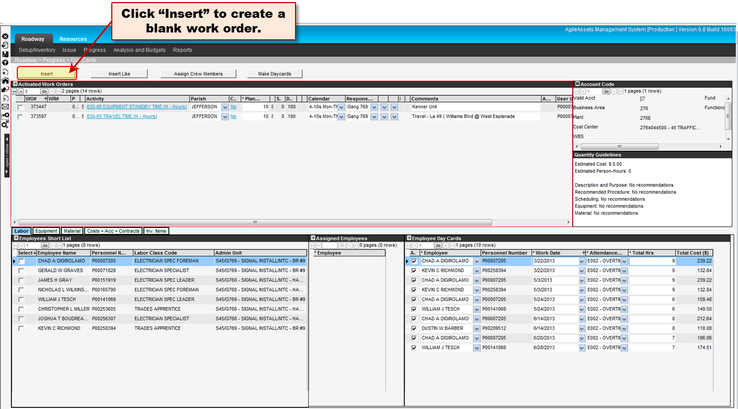
HOW TO CREATE A NEW SIGNAL WORK ORDER

Slide 5
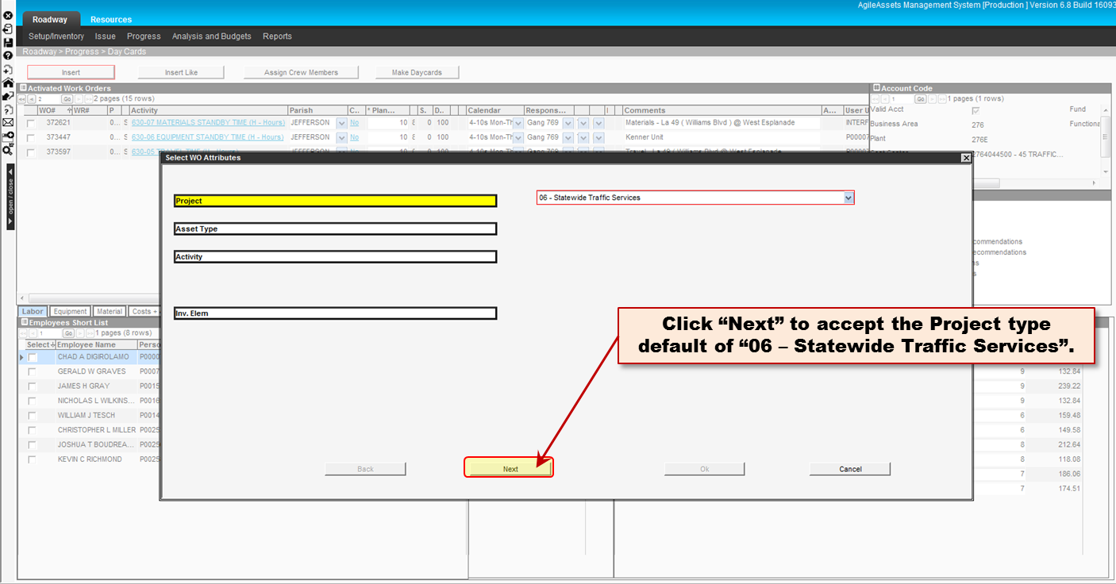
HOW TO CREATE A NEW SIGNAL WORK ORDER

Slide 6
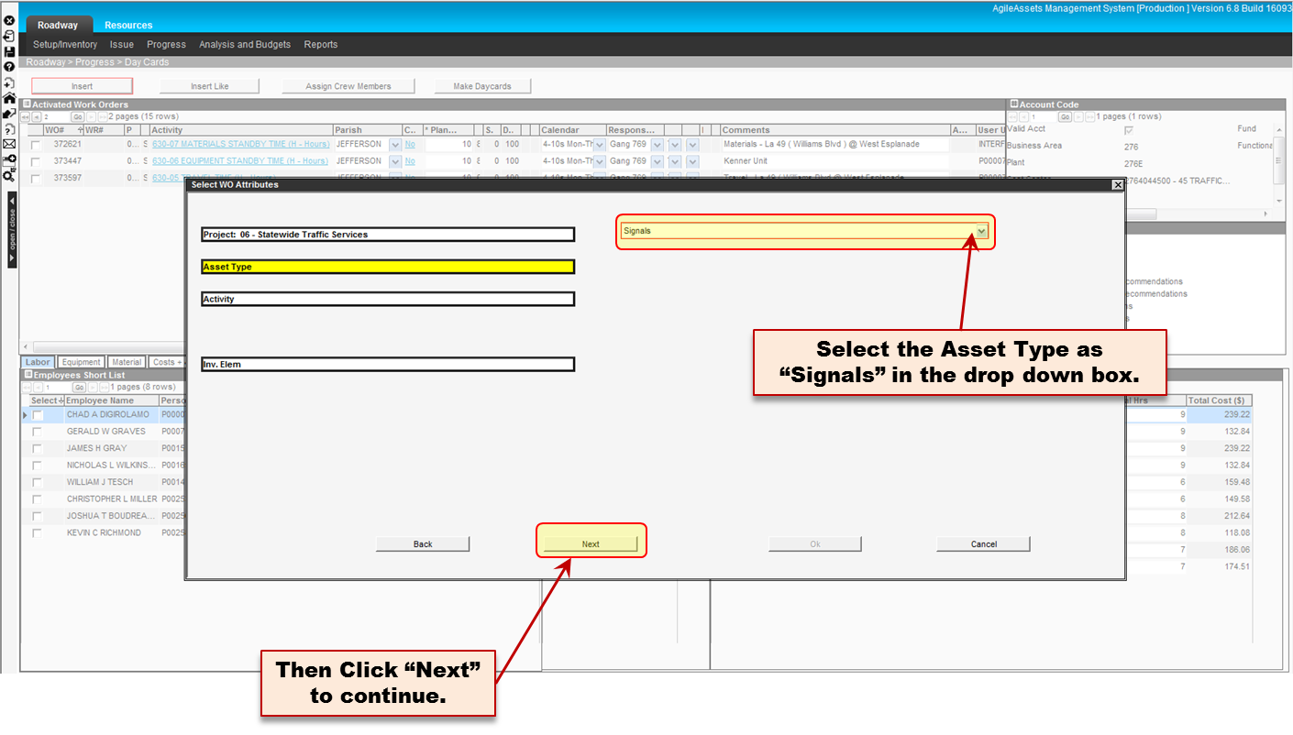
HOW TO CREATE A NEW SIGNAL WORK ORDER

Slide 7
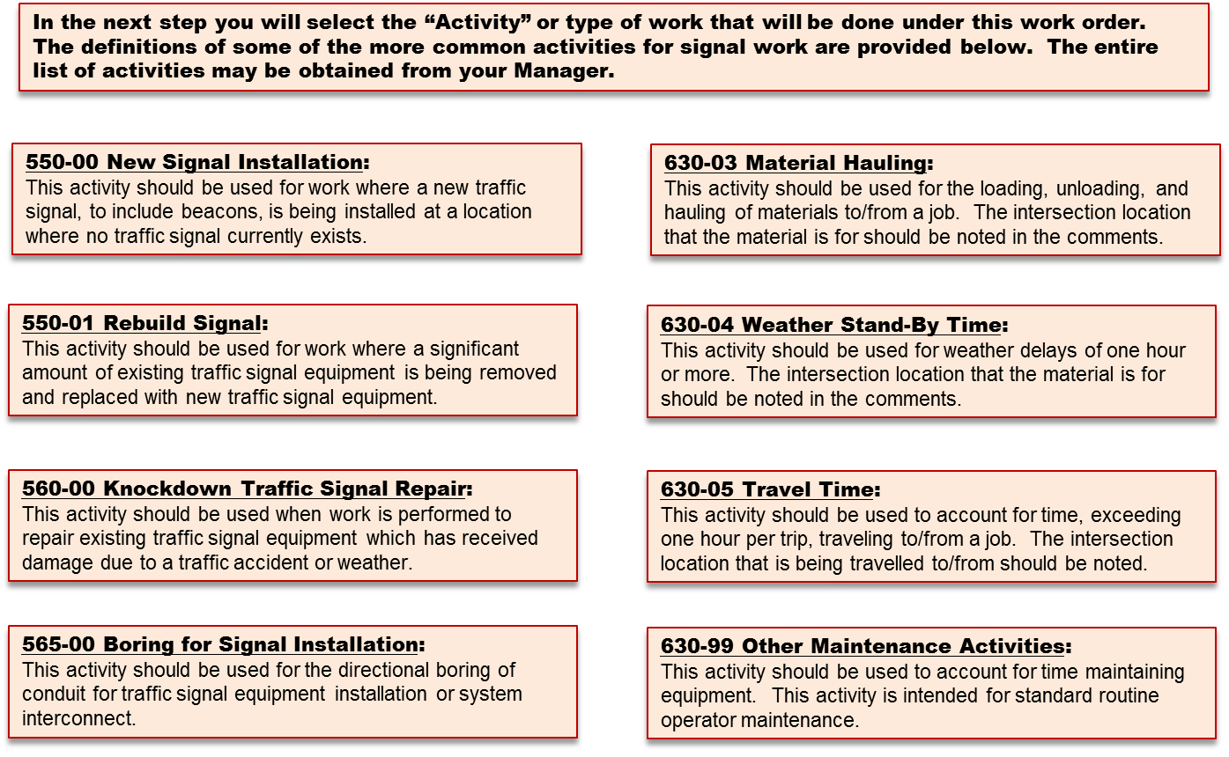
HOW TO CREATE A NEW SIGNAL WORK ORDER

Slide 8
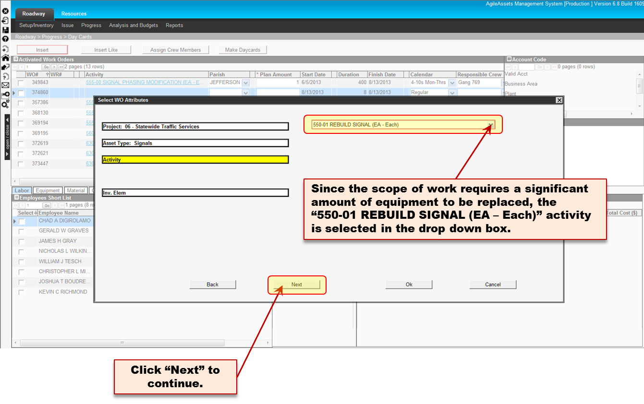
HOW TO CREATE A NEW SIGNAL WORK ORDER

Slide 9
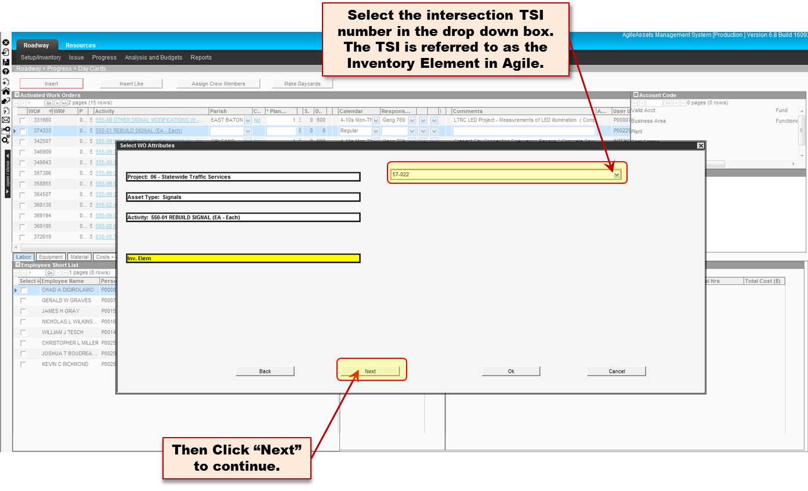
HOW TO CREATE A NEW SIGNAL WORK ORDER

Slide 10
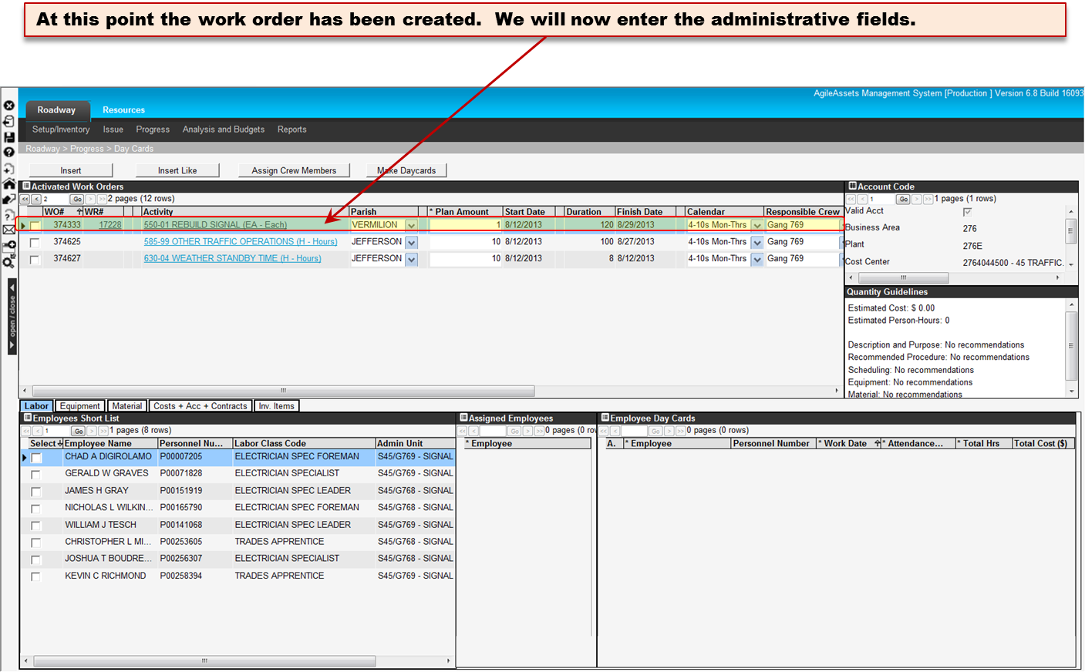
HOW TO CREATE A NEW SIGNAL WORK ORDER

Slide 11
HOW TO CREATE A NEW SIGNAL WORK ORDER

Slide 12
HOW TO CREATE A NEW SIGNAL WORK ORDER

Slide 13
HOW TO CREATE A NEW SIGNAL WORK ORDER

Slide 14
HOW TO CREATE A NEW SIGNAL WORK ORDER

Slide 15
HOW TO CREATE A NEW SIGNAL WORK ORDER

Slide 16
HOW TO CREATE A NEW SIGNAL WORK ORDER

Slide 17
HOW TO CREATE A NEW SIGNAL WORK ORDER

Slide 18
HOW TO CREATE A NEW SIGNAL WORK ORDER

Slide 19
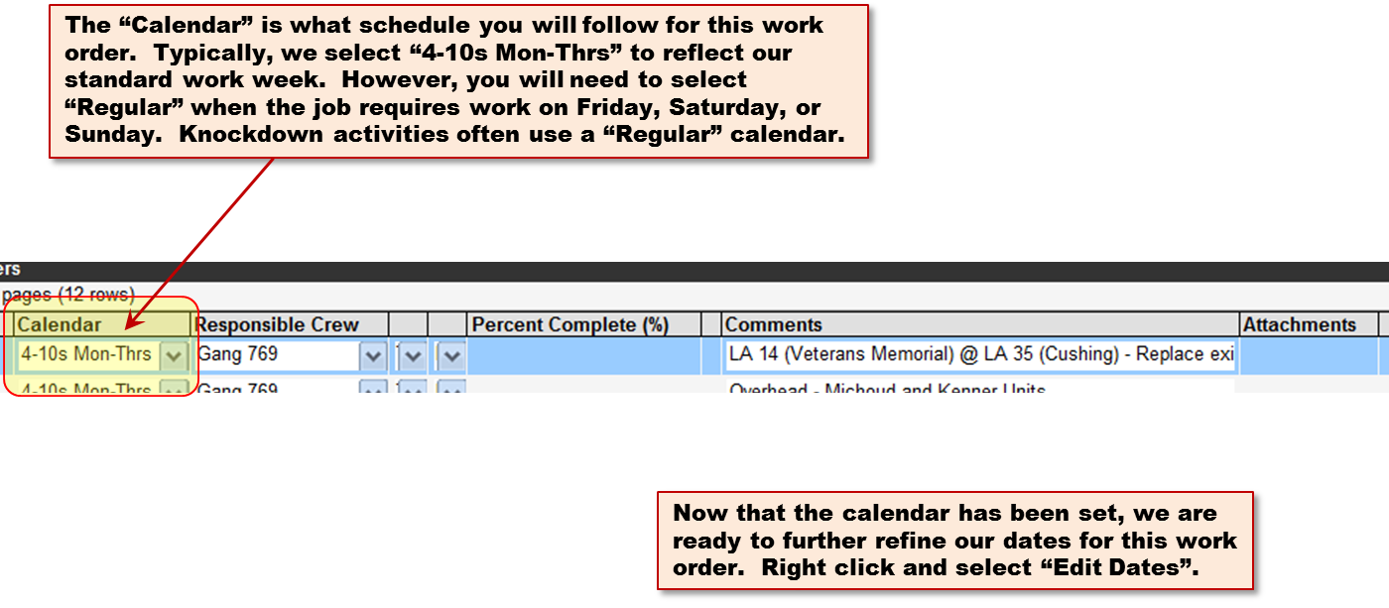
HOW TO CREATE A NEW SIGNAL WORK ORDER

Slide 20
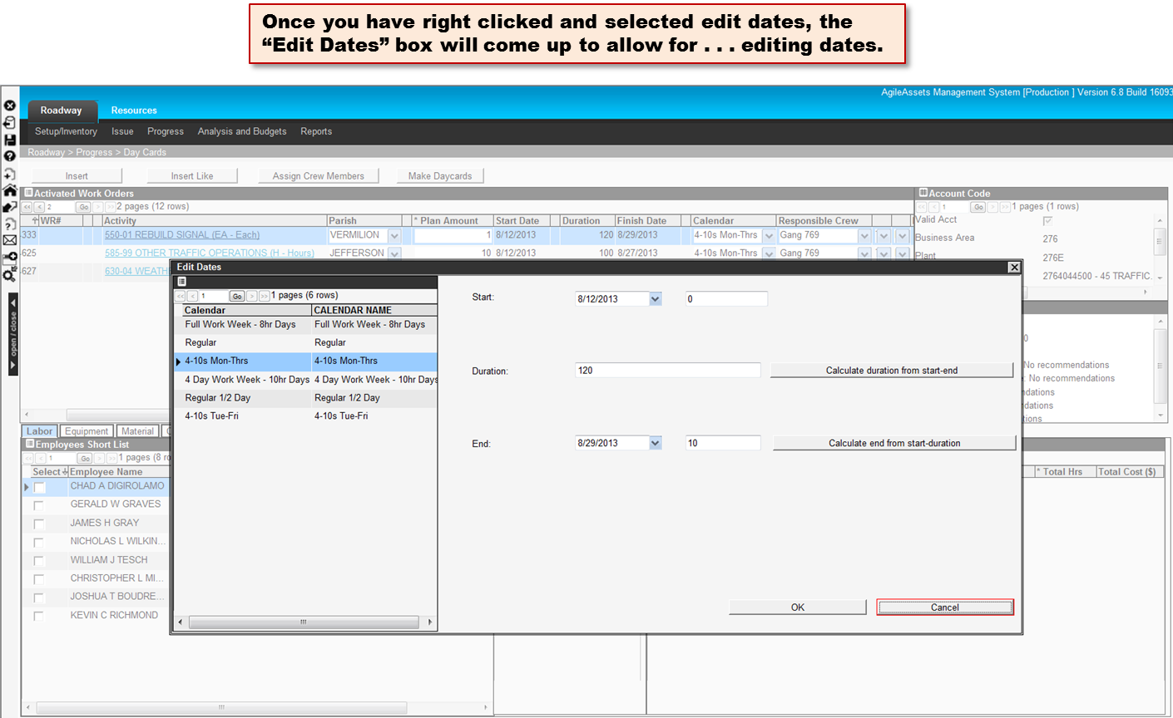
HOW TO CREATE A NEW SIGNAL WORK ORDER

Slide 21
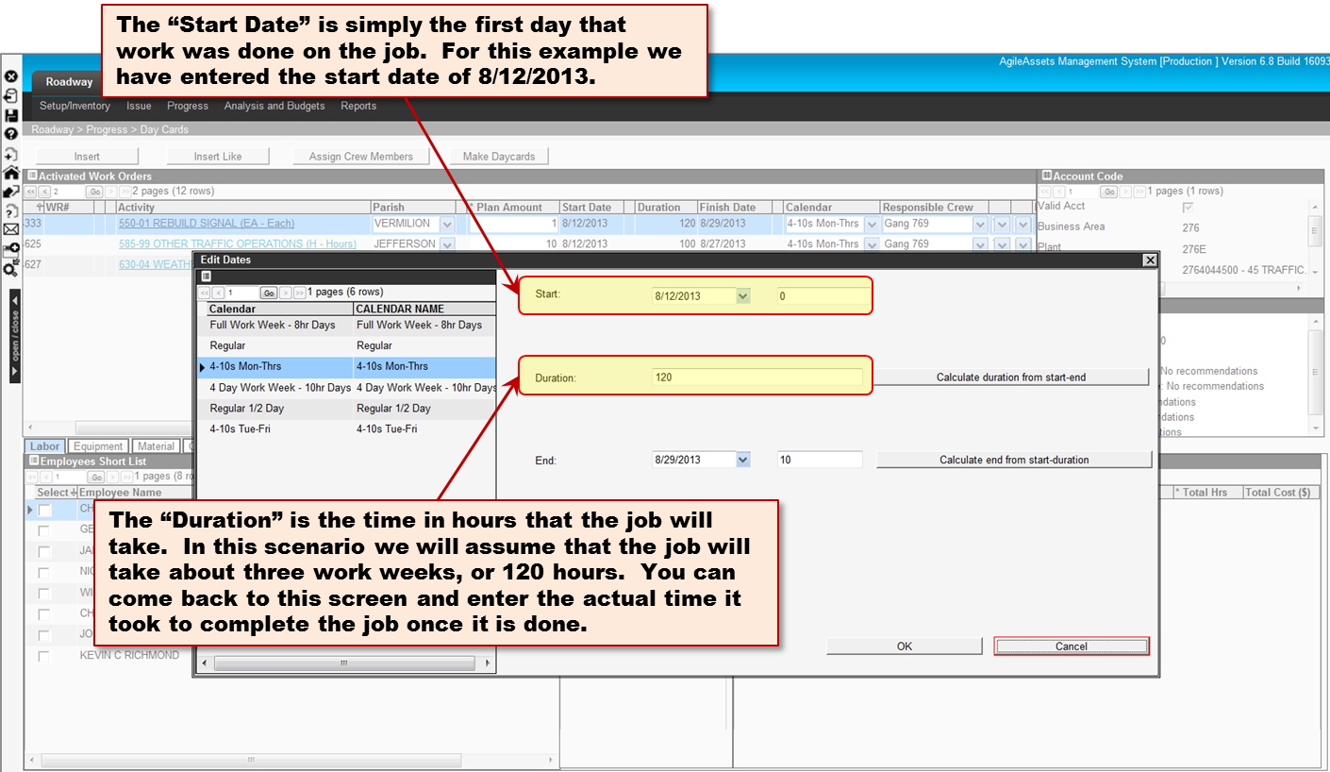
HOW TO CREATE A NEW SIGNAL WORK ORDER

Slide 22
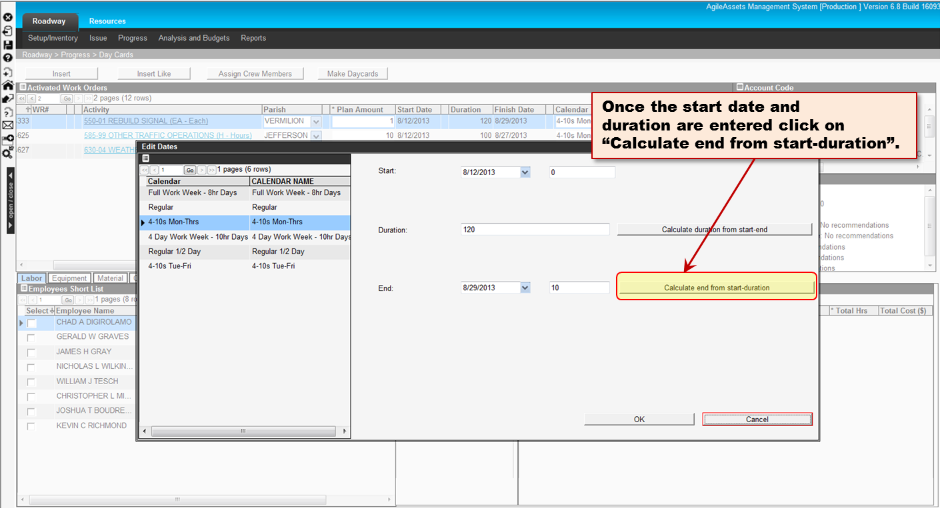
HOW TO CREATE A NEW SIGNAL WORK ORDER

Slide 23
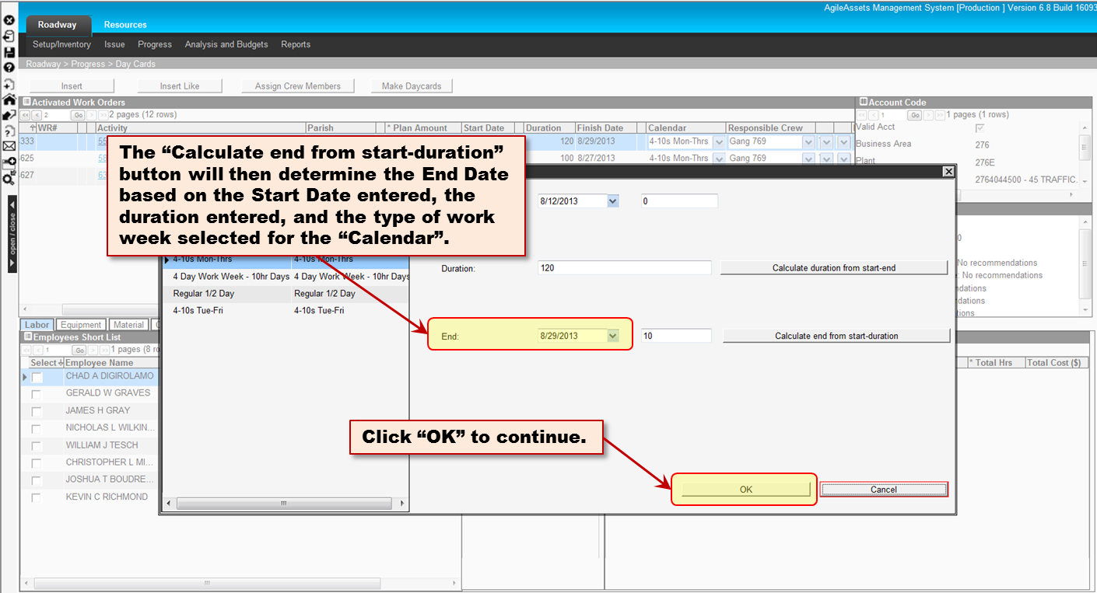
HOW TO CREATE A NEW SIGNAL WORK ORDER

Slide 24
HOW TO CREATE A NEW SIGNAL WORK ORDER

Slide 25
HOW TO CREATE A NEW SIGNAL WORK ORDER

Slide 26
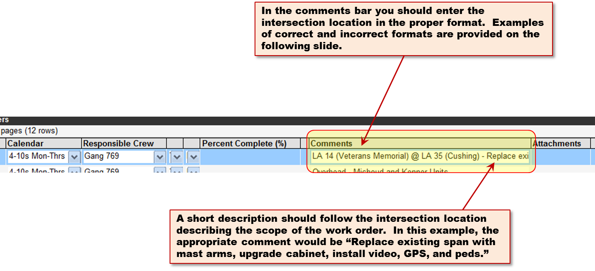
HOW TO CREATE A NEW SIGNAL WORK ORDER

Slide 27
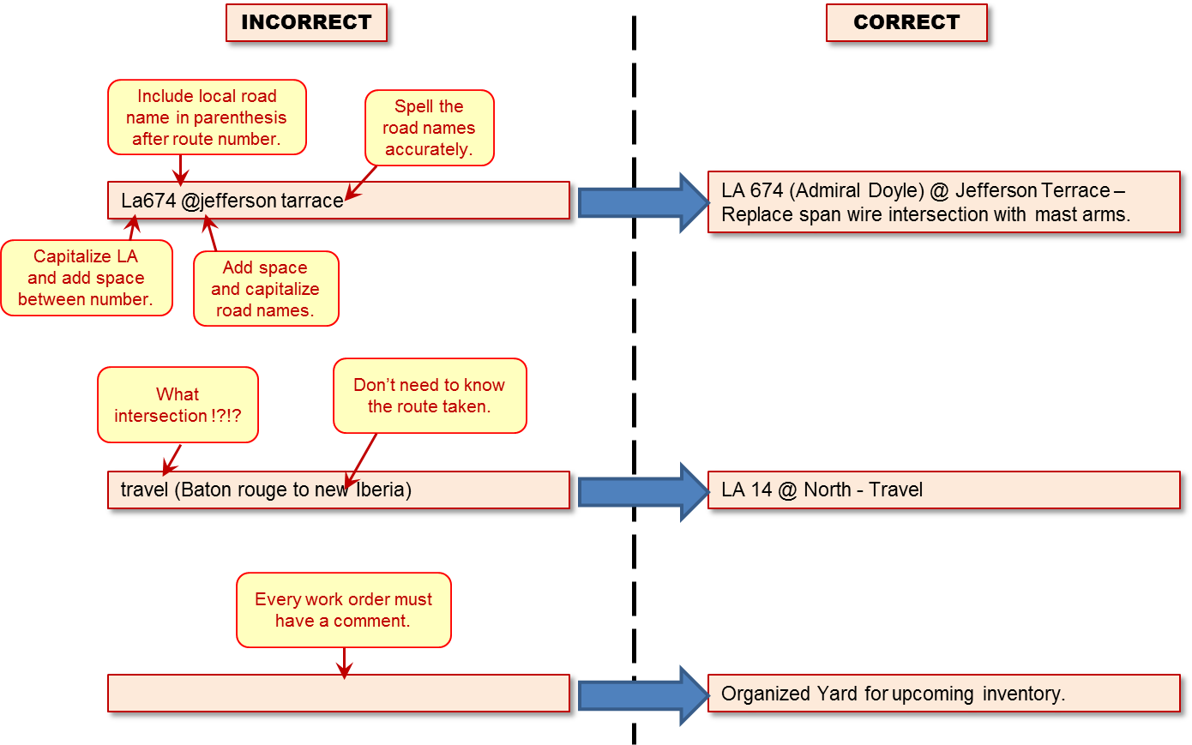
HOW TO CREATE A NEW SIGNAL WORK ORDER

Slide 28
HOW TO CREATE A NEW SIGNAL WORK ORDER

Slide 29
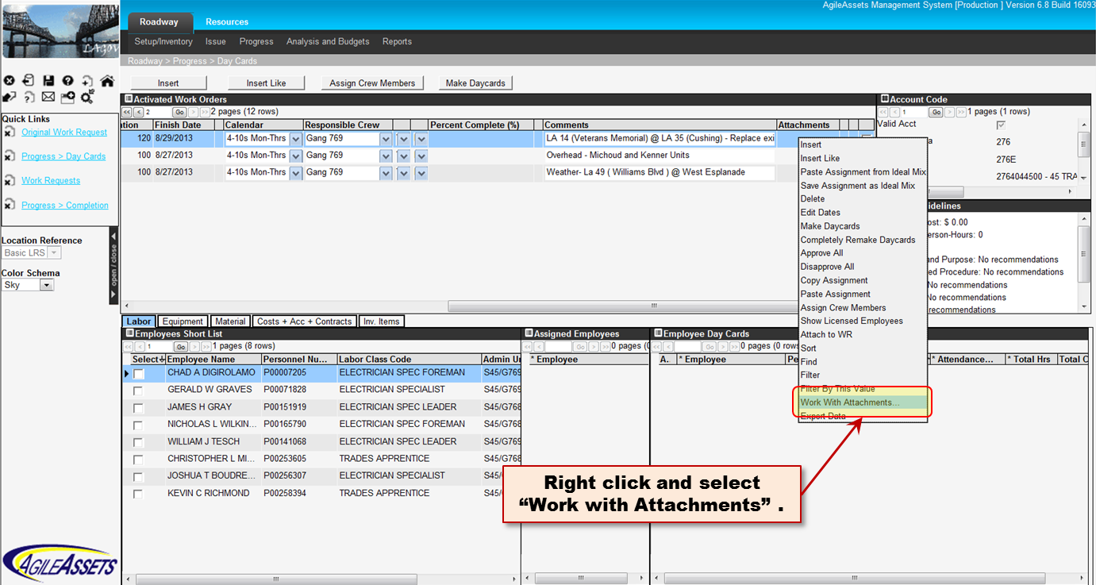
HOW TO CREATE A NEW SIGNAL WORK ORDER

Slide 30
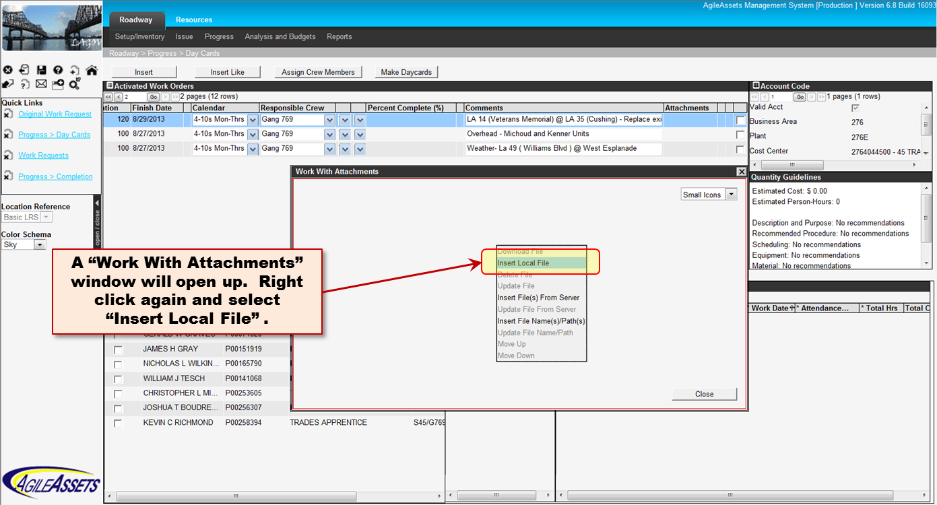
HOW TO CREATE A NEW SIGNAL WORK ORDER

Slide 31
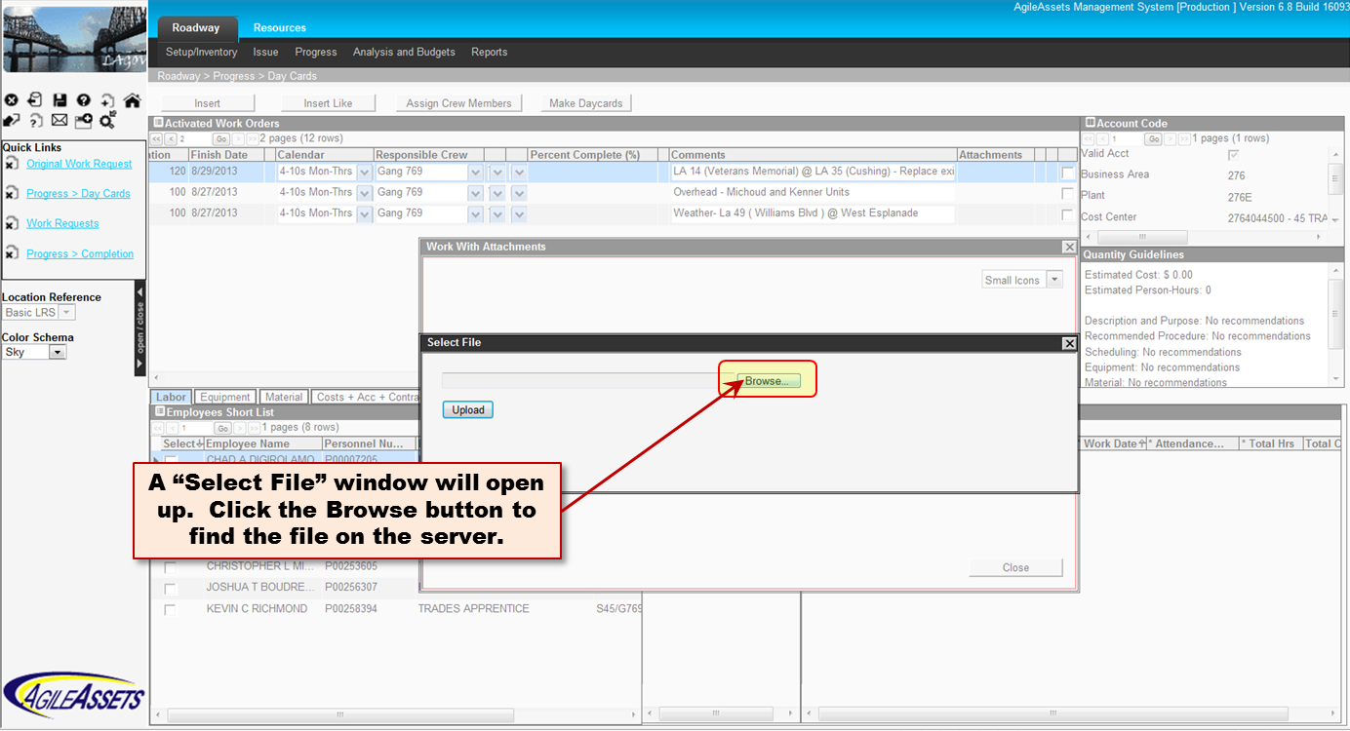
HOW TO CREATE A NEW SIGNAL WORK ORDER

Slide 32
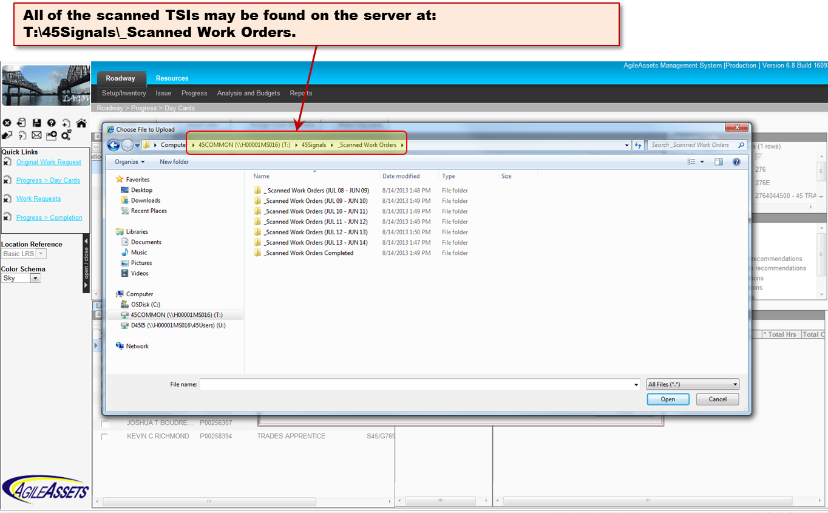
HOW TO CREATE A NEW SIGNAL WORK ORDER

Slide 33
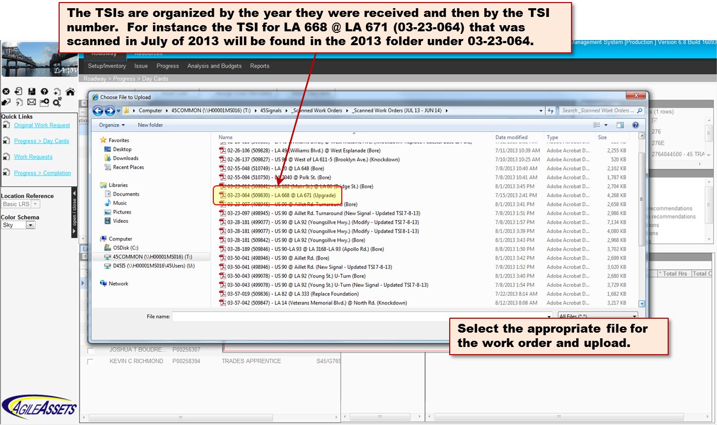
HOW TO CREATE A NEW SIGNAL WORK ORDER

Slide 34
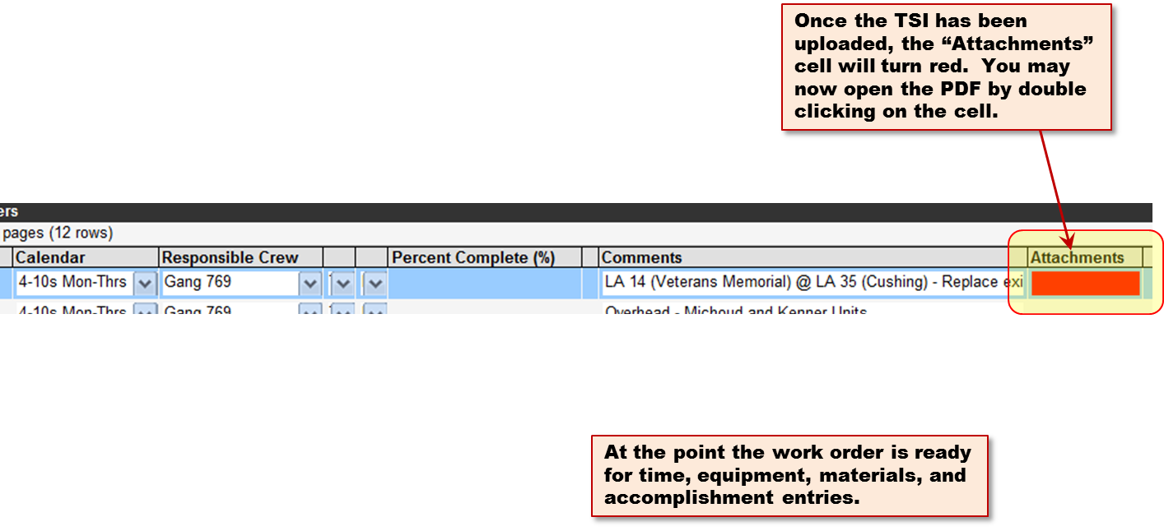
HOW TO CREATE A NEW SIGNAL WORK ORDER

Slide 35
HOW TO CREATE A NEW SIGNAL WORK ORDER

